Slide 1

FUTURE OF AUTONOMOUS CARS
Group members:
Fatima Azfar (20L-1027)
Mohammad Anas (20L-1289)
Haroon Shahid (20L-1297)
Aiman Fatima (20L-1367)

Slide 2
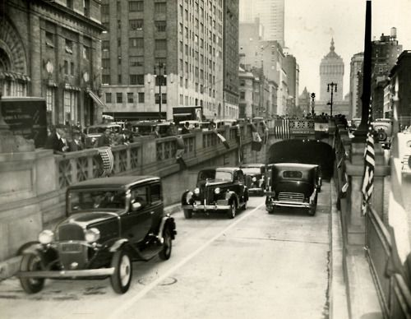
HISTORY OF AUTONOMOUS CARS
Google's self-driving Prius hybrids trace their lineage to an idea that captured the public's imagination in 1939. A look back at autonomous cars through the ages.
Now we shall discuss the background and the history of autonomous of cars in detail.

Slide 3
GLIMPSING THE FUTURE
The idea of autonomous vehicles gained widespread public exposure at General Motor’s Futurama exhibit at the 1939 World’s Fair, where the automaker envisioned "abundant sunshine, fresh air and fine green parkways" upon which cars would drive themselves.

Slide 4
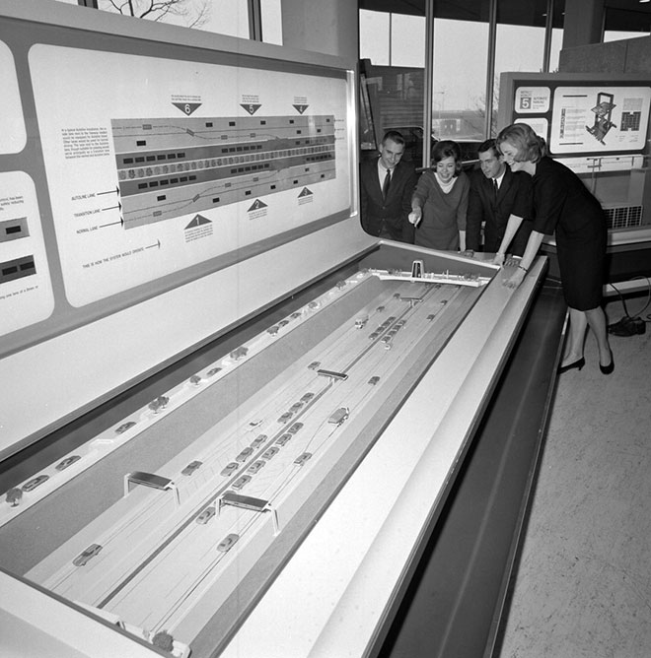
INNOVATIONS TOWARDS AUTOMATION
By 1953, historian Jameson Wetmore wrote in Driving the Dream, GM(General Motors) and RCA(Radio Corporation of America) had developed a scale model automated highway system, which allowed them to begin experimenting with how electronics could be used to steer and maintain proper following distance. In 1958, Wetmore notes, the company tested a 1958 Chevrolet with a front-end featuring "pick-up coils" that could "sense the alternating current of a wire embedded in the road and would adjust the steering wheel accordingly." As GM described it, "The car rolled along the two-lane check road and negotiated the banked turn-around loops at either end without the driver’s hands on the steering wheel."

Slide 5
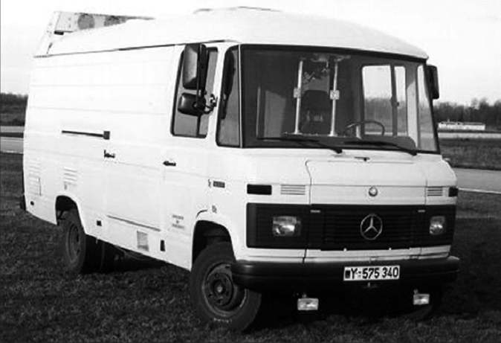
FURTHER INNOVATIONS BY DIFFERENT NATIONS
In 1977, the Japanese improved upon this idea, using a camera system that relayed data to a computer to process images of the road. However, this vehicle could only travel at speeds below 20 mph. Improvement came from the Germans a decade later in the form of the VaMP (one of the first truly autonomous car), a vehicle outfitted with cameras that could drive itself safely at 56 mph. As technology improved, so did self-driving vehicles’ ability to detect and react to their environment.

Slide 6
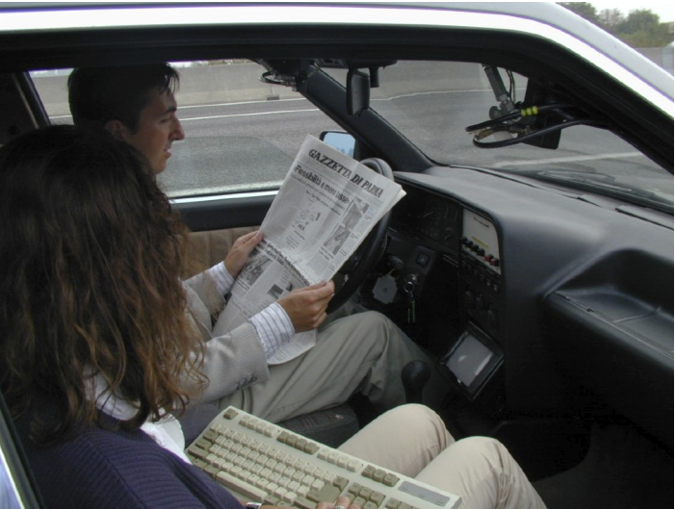
ARGO Project, Universities of Parma and Pavia An offshoot of the European PROMETHEUS project, the ARGO team drove their Lancia Theme testbed car 1200 miles around Italy in 1996, 94% of the time in autonomous mode.

Slide 7
HOW AUTONOMOUS CARS WORK?
Cars today already include many semi-autonomous features, like assisted parking and self-braking systems. And completely autonomous vehicles—able to operate without human control—are rapidly becoming more of a reality. You’re probably familiar with Google’s version, which has made headlines with its Google Chauffeur software, which the company hopes to bring to market by 2020.
Now, we shall discuss the basic working mechanisms of an autonomous car.

Slide 8
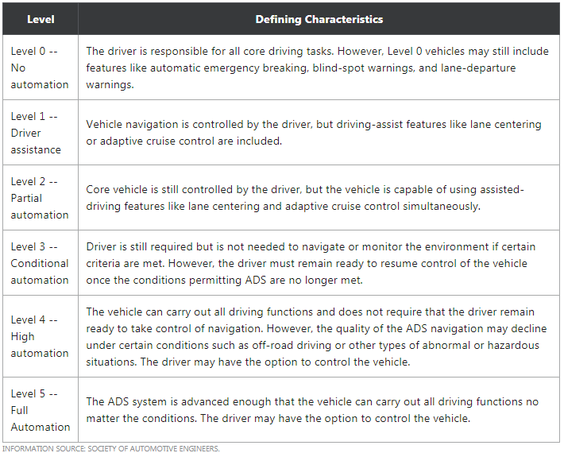
CLASSIFICATION OF AUTONOMOUS CARS
A classification system based on six different levels (ranging from none to fully automated systems) was published in 2014 by SAE International (Society of Automotive Engineers)

Slide 9
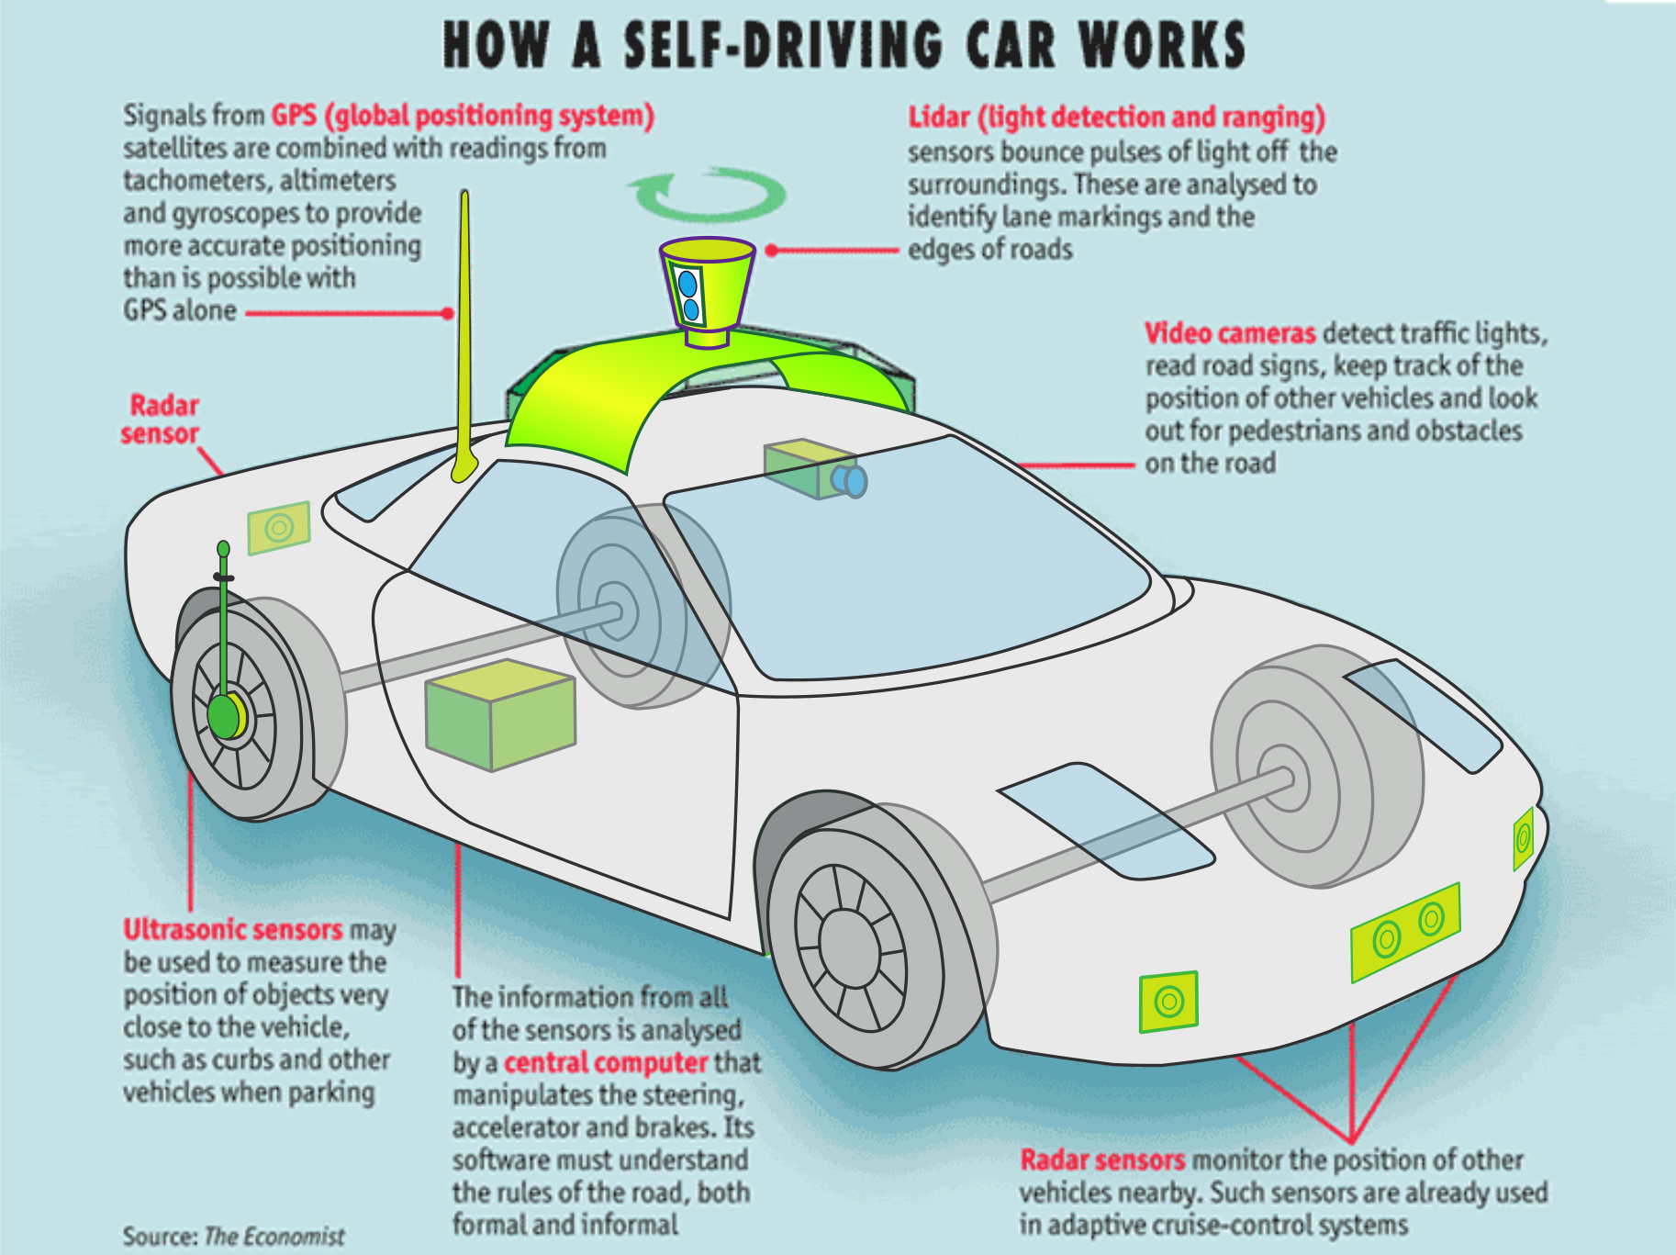
WORKING MECHANISM

Slide 10
TECHNOLOGY USED IN AUTONOMOUS CARS
Autonomous cars use a variety of techniques to detect their surroundings, such as radar, laser light, GPS, odometers, and computer vision. Advanced control systems interpret sensory information to identify appropriate navigation paths, as well as obstacles and relevant signage. Autonomous cars have control systems that are capable of analyzing sensory data to distinguish between different cars on the road, which is very useful in planning a path to the desired destination.

Slide 11
WHAT DOES AN AUTONOMOUS CAR ACTUALLY DO?
Driver sets a destination and car’s software calculates a route and starts the car on its way. A rotating, roof-mounted LIDAR sensor monitors a 60-meter range around the car and creates a dynamic 3-D map of the car’s current environment. A sensor on the left rear wheel monitors sideways movement to detect the car’s position relative to the 3-D map. Radar systems in the front and rear bumpers calculate distances to obstacles. Artificial intelligence software in the car is connected to all the sensors and has input from Google Street View and video cameras. The AI simulates human perceptual and decision- making processes and controls driving systems such as steering and brakes. The car’s software consults Google Maps for advance notice of things like landmarks and traffic signs and lights. An override function is available to allow a human to take control of the vehicle. Individual vehicles may benefit from information obtained from other vehicles in the vicinity, especially information relating to traffic congestion and safety hazards. Vehicular communication systems use vehicles and roadside units as the communicating nodes in a peer-to-peer network, providing each other with information.

Slide 12
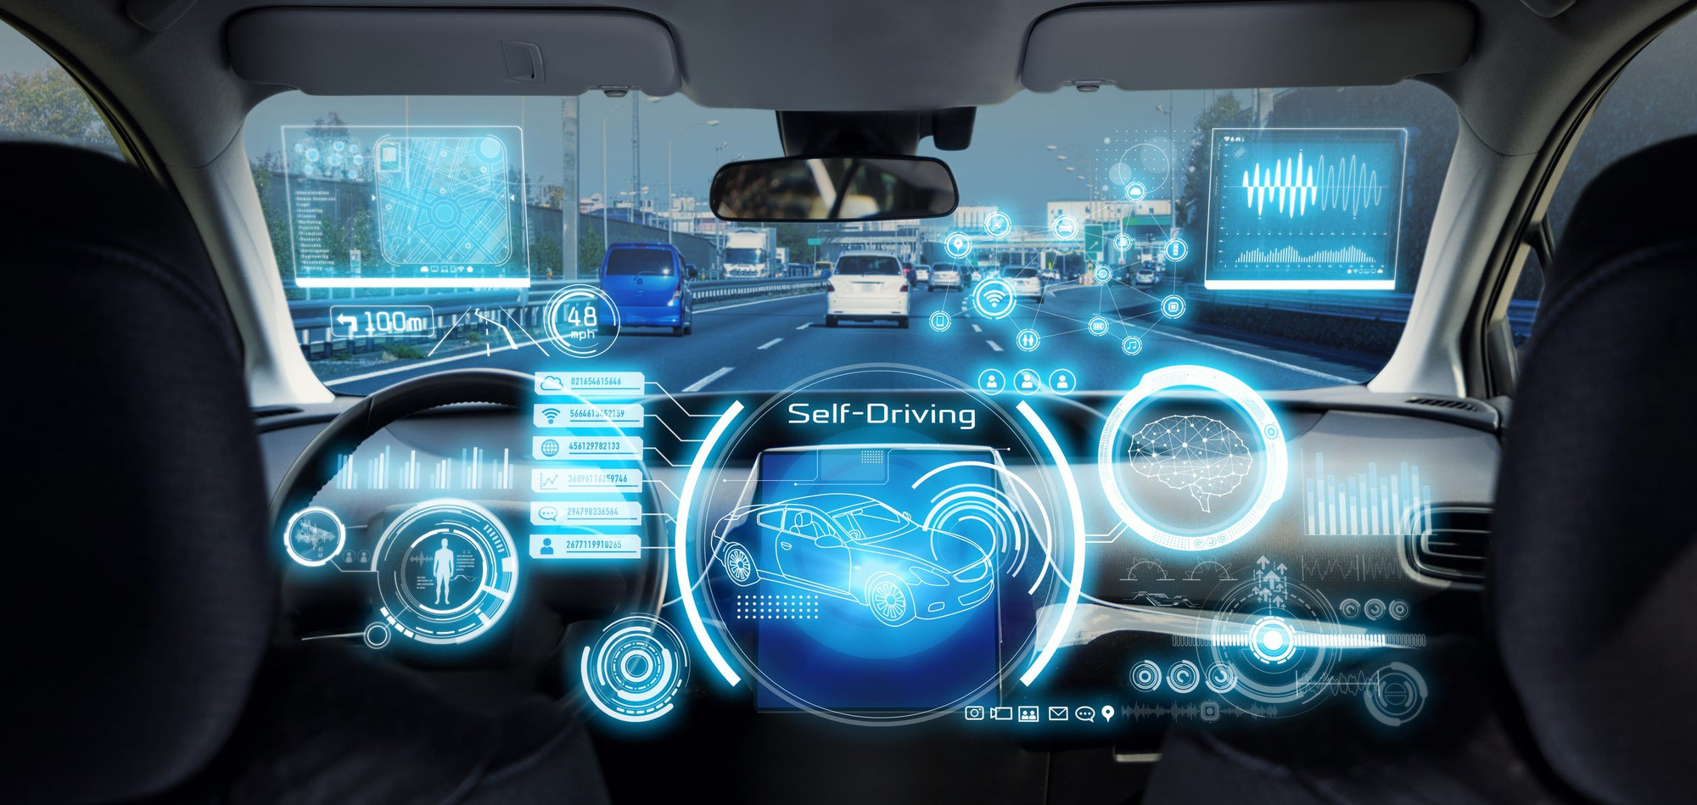
AUTONOMOUS CARS AND TODAY’S WORLD
In the past 60 years or so, we’ve had a handful of tests around the world, but it’s really been the last 5-10 years that have seen the most progress in the development and most importantly the testing of these new technologies.
Now, we shall discuss the current state of autonomous cars.

Slide 13
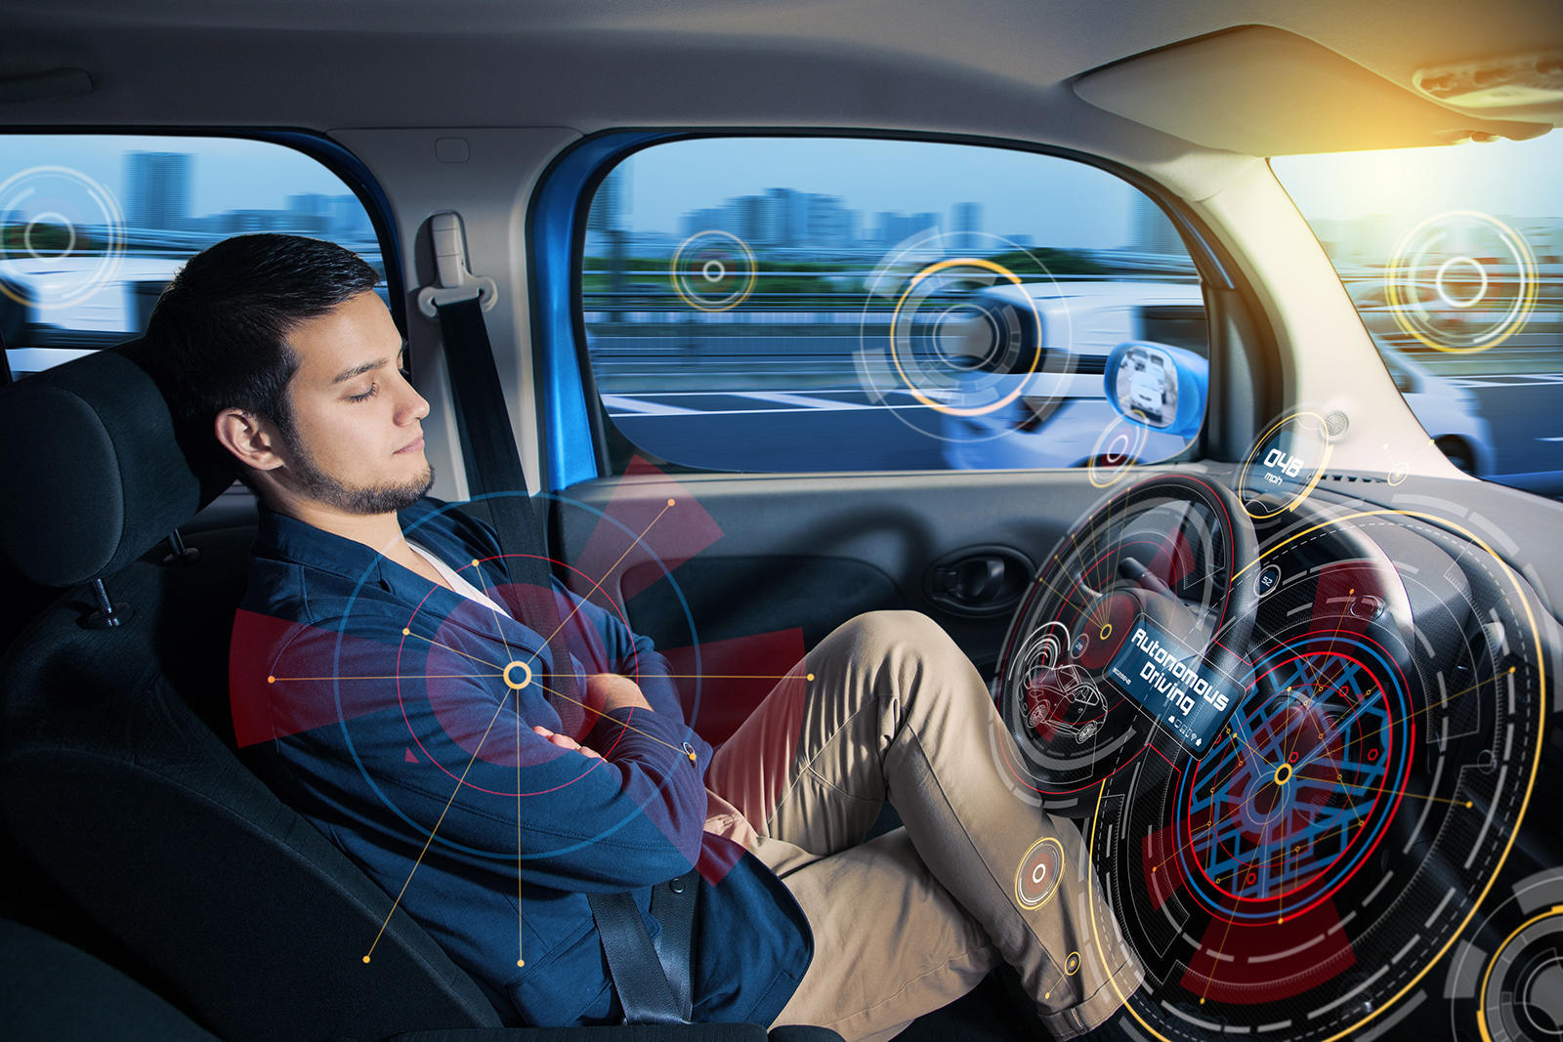
MAJOR MANUFACTURERS OF AUTONOMOUS CARS
Tesla is also making big steps forward in taking autonomy into mainstream use, both in terms of real world use cases and potential monetization of self-driving technologies. Tesla has supplied customers with more than 780,000 vehicles since launching, the majority of which arrive with pre-installed, self-driving capabilities available to users who purchase the requisite software.
In 2010, internet giant Google announced that some of its employees had spent the previous year secretly developing and testing a system for a self-driving car in the hopes of finding a solution that would reduce the number of car accidents each year by half.
Ford is another manufacturer with deployments already in play, with self-driving vehicles being tested in Pittsburgh, Palo Alto, Miami, Washington D.C. and Detroit, with Austin, Texas joining them soon.

Slide 14
USAGE OF AUTONOMOUS VEHICLES
Autonomous vehicles are gradually finding their way onto our roads. Earlier this year, Waymo, the self-driving unit of Google's sister-company Alphabet, carried out successful trials of autonomous taxis in California, transporting over 6,200 people in the first month and many thousands since. They’re proving a practical business case for autonomous vehicles.
Also in the U.S., Walmart is using autonomous cargo vans to deliver groceries in Arizona, while Pizza Hut is working with Toyota on a driverless electric delivery vehicle that even has a mobile kitchen in it to cook pizzas en-route to your house.

Slide 15
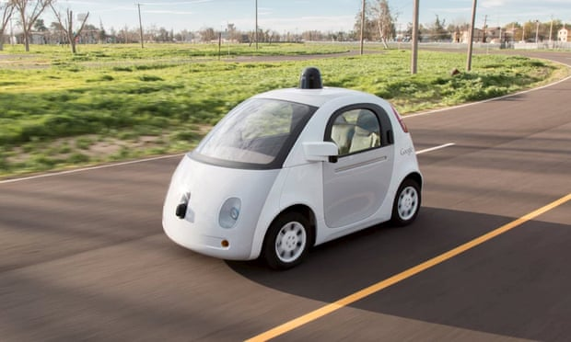
As self-driving vehicles edge closer to our roads, what does the new technology mean for services and businesses in cities?
Google’s autonomous vehicle is one example of a self-driving car – but what impact will these cars have on cities?

Slide 16
SOCIAL ACCEPTABILITY
There have been numerous high-profile accidents involving Tesla’s current automated cars, as well as with other automated and autonomous vehicles. Social acceptability is not just an issue for those wishing to buy a self-driving car, but also for others sharing the road with them.
The public needs to be involved in decisions about the introduction and adoption of self-driving vehicles. Without this, we risk the rejection of this technology.

Slide 17
FUTURE OF AUTONOMOUS CARS
Self-driving cars are poised to revolutionize the transportation industry. There have been many significant shifts in the auto industry since the beginning of commercial auto production roughly eight decades ago, but the basic formula of a human operator guiding a vehicle using a steering wheel and pedals has held pretty steady across that time span.
Now, we shall discuss the future of autonomous cars.

Slide 18
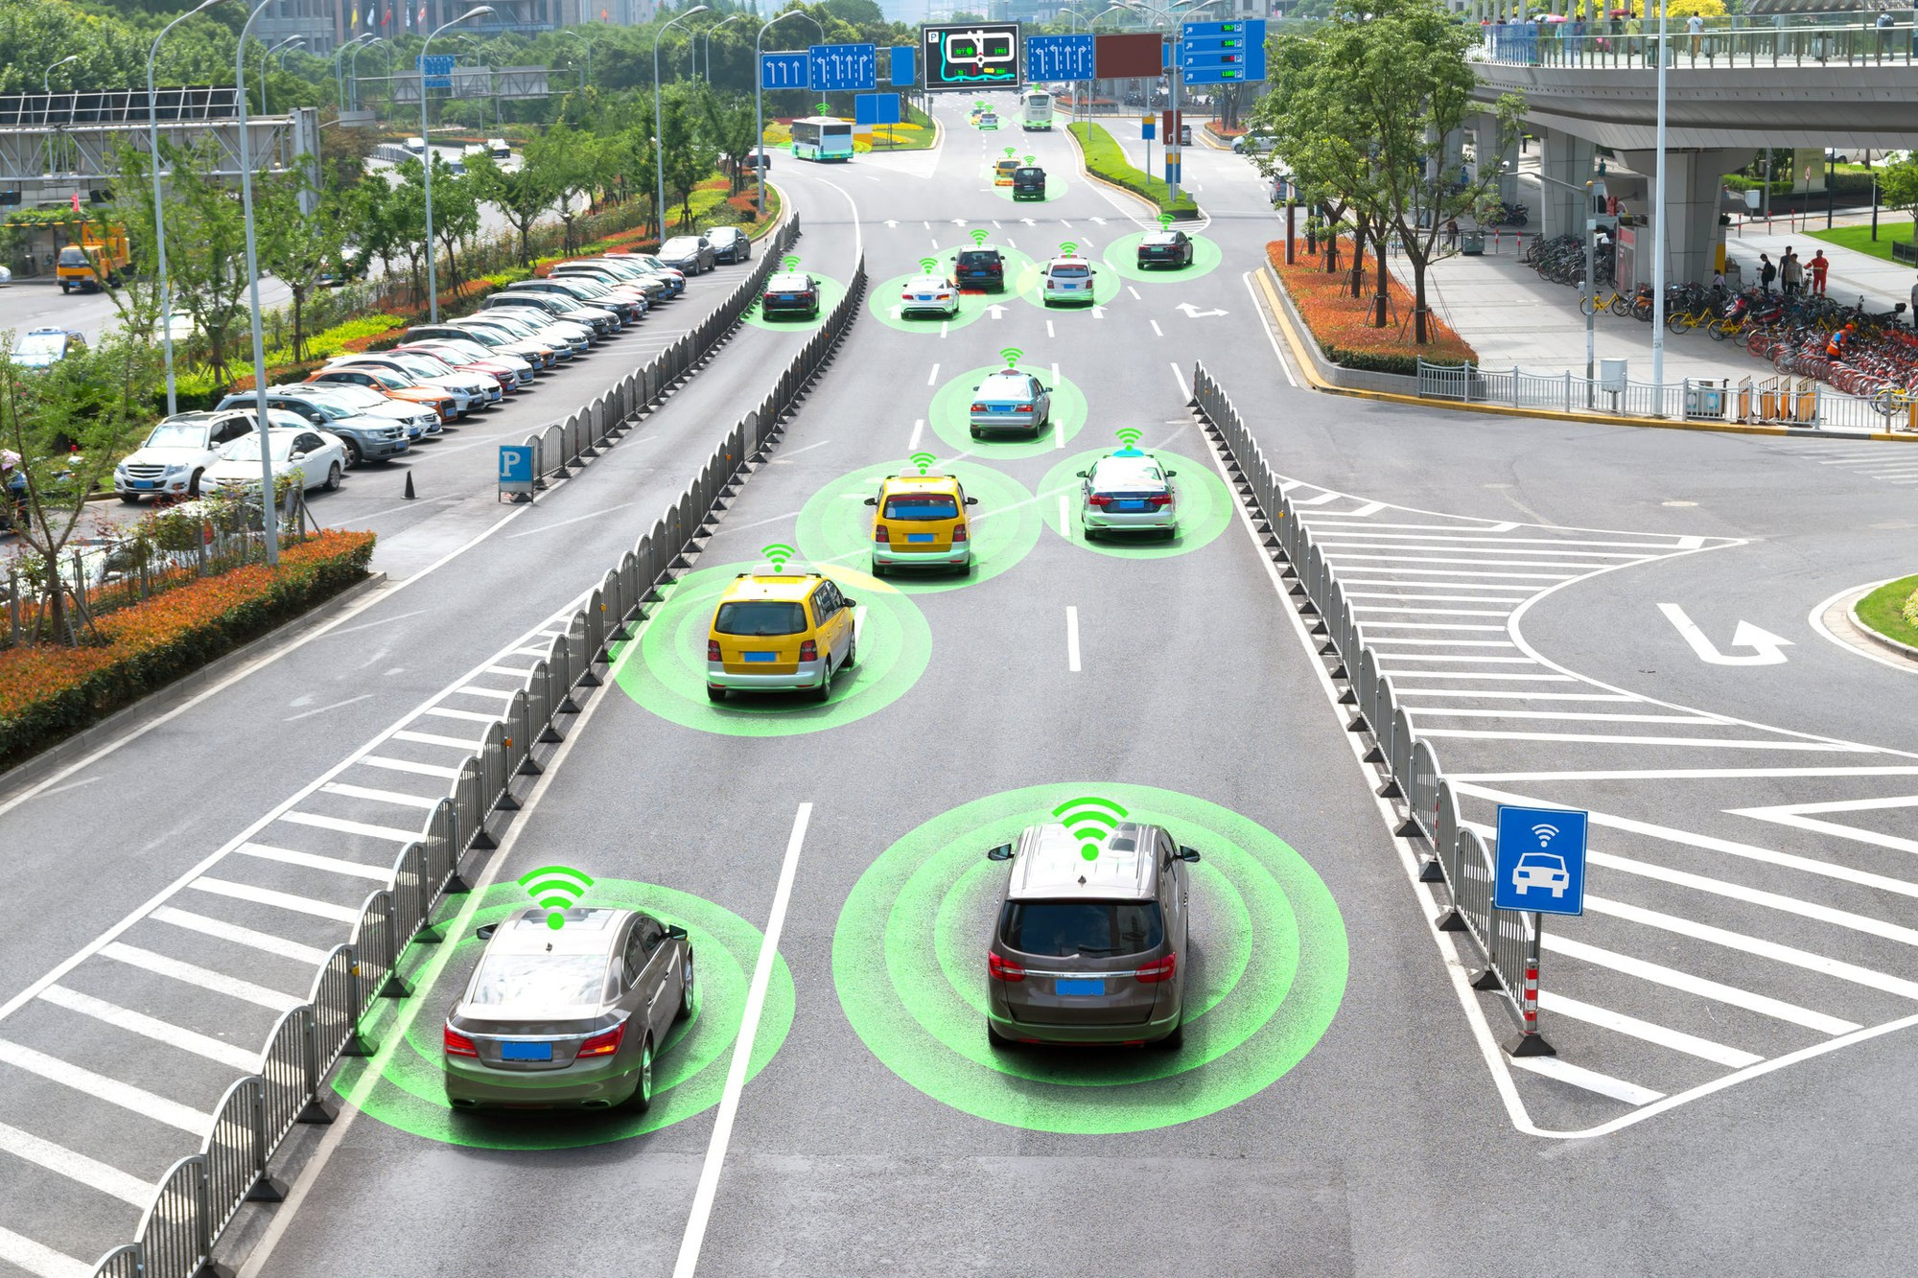
ARE SELF-DRIVING CARS SAFE?
Some reports and experts suggest that ADS vehicles are already safer than human-operated vehicles when it comes to performing some driving functions. Self-driving cars don't suffer from sleep deprivation, and they can't drive under the influence of drugs or alcohol. They also have wider fields of vision and are designed to obey traffic laws, while human drivers will sometimes disregard laws or fail to follow them due to being distracted.
In January 2016, a man was killed in China after his Tesla crashed into the back of a cleaning vehicle. The Tesla reportedly had its self-driving features activated at the time of the crash. This marked the first reported death in which a vehicle's ADS features were viewed as a potential contributing factor, although the police did find that the Tesla driver had not been paying attention to the road in accordance with the autopilot rules.

Slide 19
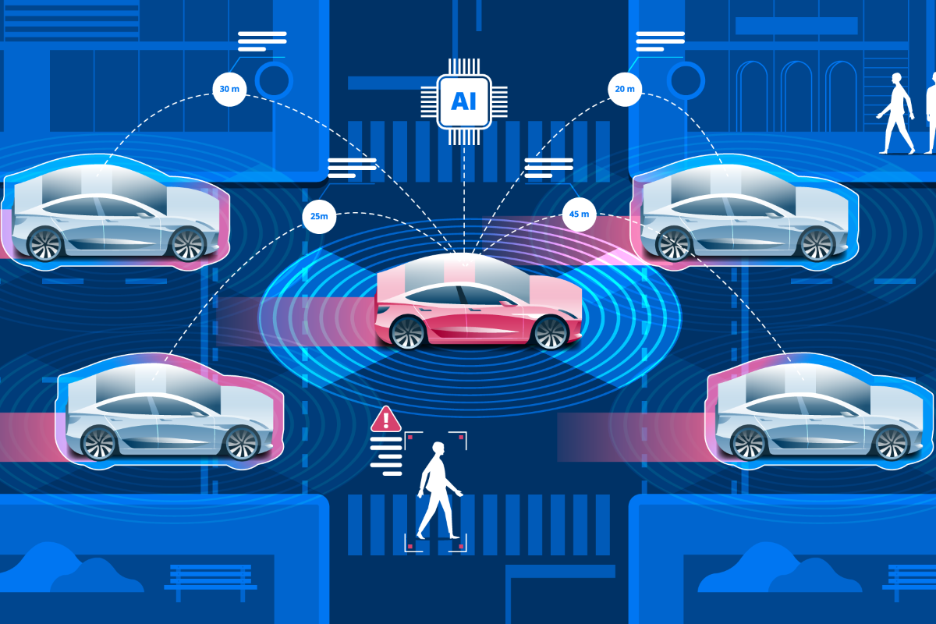
WILL PEOPLE ACCEPT SELF-DRIVING CARS?
Self-driving cars have some perception issues to overcome. The 2019 installment of AAA's annual autonomous-vehicle survey found that 71% of people surveyed would be afraid to ride in fully autonomous vehicles -- down slightly from the 73% of respondents in 2018 and up substantially from the 63% of respondents who said that they would be scared to be a passenger in a driverless vehicle in 2017. Just 19% of respondents in the 2019 survey said that they would be comfortable with putting their children and other family members in autonomous vehicles.
Data shows that people are cautious about ADS technology and that many will need to see evidence that it is safer than having people drive before embracing it.

Slide 20
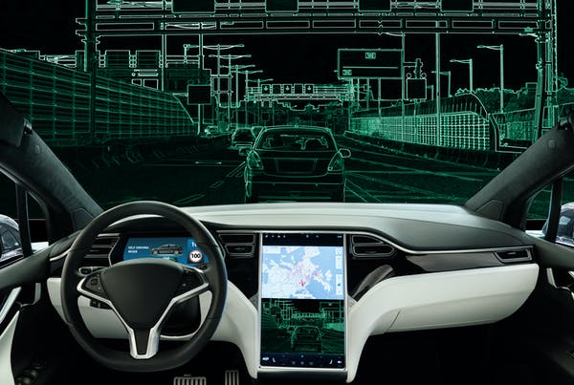
WHAT BENEFITS COULD SELF-DRIVING CARS OFFER?
If self-driving technology continues to progress as many analysts anticipate, autonomous vehicles could actually dramatically reduce the occurrence of automotive accidents. Tens of thousands of people in the U.S. are killed in car accidents each year, and many more people are injured.
Having self-driving cars could also give people a lot more free time. Commutes might be spent working on projects, talking to other passengers, or watching a favorite television show on an in-vehicle entertainment system. While many people enjoy driving, the opportunity to get things done or enjoy leisure time while in transit could translate to significant productivity and quality-of-life improvements.

Slide 21
COULD DRIVERLESS VEHICLES COMPLETELY REPLACE REGULAR CARS?
With a staggering number of deaths and massive expenses stemming from automobile accidents due to human error, some people have asked whether human driving might be phased out if autonomous vehicles are shown to be significantly safer. The argument could be made that failing to fully transition to autonomous transport will result in lives being lost, unnecessary damage being incurred, and energy resources being wasted.
As Elon Musk and others have pointed out, it is possible that significant safety improvements brought about by driverless cars could result in government efforts to further regulate or outright ban human-operated vehicles. It might seem far-fetched at present, but no one can say with certainty what the future holds, and evidence showing that accidents would be reduced and lives would be saved could be very persuasive.

Slide 22
CONCLUSION
You’ll certainly get to see ADS cars driving around casually in a decade or so, you might be driving one yourself!

